Slide 1
Func, Action and Predicate

Slide 2
Func
Define a delegate that takes parameters and returns a value.
The last type parameter specifies the return type, while the preceding type parameters specify the input types.

Slide 3


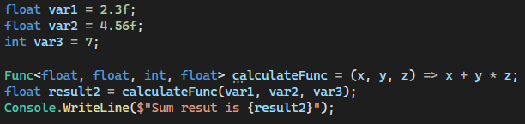

Example

Slide 4
Action
Define a delegate that takes parameters but does not return a value.

Slide 5
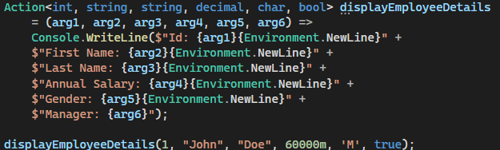
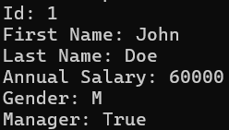
Example

Slide 6
Predicate
define a delegate that takes a parameter and returns a Boolean value.

Slide 7
Example

